Slide 1

8255 Programmable Peripheral Interface
(UNIT-4)
(SUB: Microprocessor and Interfaces)
PREPARED BY:
ER. MOHIT MISHRA
ASSOCIATE PROFESSOR
COMPUTER SCIENCE DEPARTMENT
Notes:
HIIIIIIIIIIIIIIIIIIIIIIIIIIIIIIIIIIIIIIII

Slide 2
TOPIC COVERED
The BASICS OF 8255 PPI
PIN DETAILS
INTERNAL BLOCK DIAGRAM OF 8255
BLOCK DIAGRAM FEATURES
DIFFERENT MODES OF 8255
CONTROL WORD FORMAT FOR BIT SET RESET MODE
CONTROL WORD FORMAT FOR I/O MODE
Notes:
HIIIIIIIIIIIIIIIIIIIIIIIIIIIIIIIIIIIIIIII

Slide 3
The BASICS OF 8255 PPI
PPI = Programmable Peripheral Interface
The 8255 allows the microprocessor to communicate with the outside world through three programmable 8-bit wide I/O ports
The PC uses a few 8255 (in the chip set) to control the keyboard, speaker, and parallel port
The 8255 PPI is available in DIP or surface mount forms
Also implemented as functions within modern interface chip sets

Slide 4
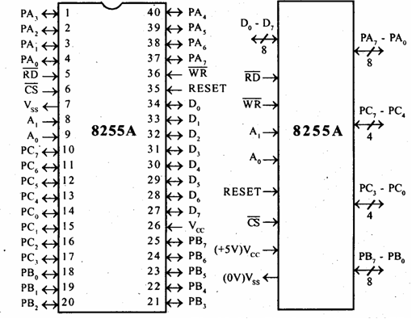
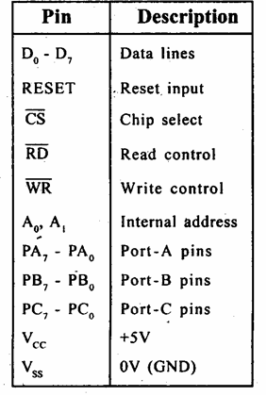
PIN DETAILS

Slide 5
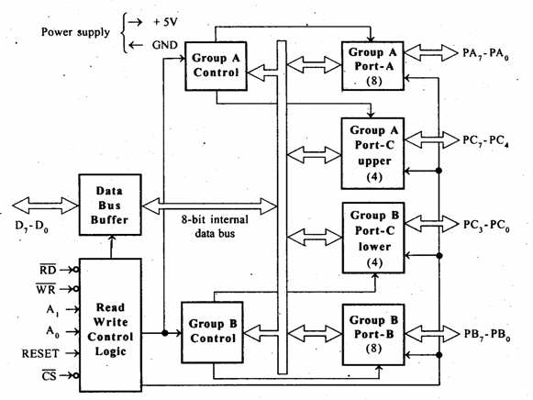
INTERNAL BLOCK DIAGRAM OF 8255

Slide 6
BLOCK DIAGRAM FEATURES
Data bus buffer:
This is a tri state bidirectional buffer used to interface the 8255 to system data bus. Data is transmitted or received by the buffer on execution of input or output instruction by the CPU.
• Control word and status information are also transferred
through this unit.

Slide 7
READ/WRITE CONTROL LOGIC
This unit accepts control signals ( RD, WR ) and also inputs from address bus and issues commands to individual group of control blocks
( Group A, Group B).It has the following pins.
a) CS – Chipselect : A low on this PIN enables the
communication between CPU and 8255.
b) RD (Read) – A low on this pin enables the CPU to read
the data in the ports or the status word through data bus buffer.
c) WR ( Write ) : A low on this pin, the CPU can write
data on to the ports or on to the control register through
the data bus buffer.
d) RESET: A high on this pin clears the control register
and all ports are set to the input mode
e) A0 and A1 ( Address pins ): These pins in conjunction
with RD and WR pins control the selection of one of the
3 ports.

Slide 8
I/O PORT ASSIGNMENTS
Group A is Port A and upper ½ of Port C (PC7-PC4).
Group B is Port B and lower ½ of Port C (PC3-PC0).
A1 | A0 | Function
0 | 0 | Port A
0 | 1 | Port B
1 | 0 | Port C
1 | 1 | Command Register
Writing into this register
programs the various ports to operate in
various modes and be used
as either inputs or outputs

Slide 9
I/O PORT ADDRESS
Data bus
D[7:0]
PA[7:0]
A0
8085
A1
PB[7:0]
RD
Control port
WR
PC[7:0]
RESET
A7
CS
A6
A5
A1 A0
Port
A4
A3
0 0
0 1
0
1 1
PA
PB
PC
Control
A2
IO/M

Slide 10
DIFFERENT MODES OF 8255
8255 has two different modes:
Bit Set – Reset mode
I/O modes
I/O mode further divided into three modes
MODE 0
MODE 1
MODE 2

Slide 11
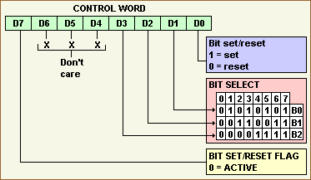
CONTROL WORD FORMAT FOR BIT SET RESET MODE

Slide 12
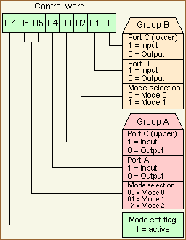
CONTROL WORD FORMAT FOR I/O MODE

Slide 13
I/O MODE
Mode 0: Simple Input or Output
Ports A, B, and C can be individually programmed as input or output ports
Port C is divided into two 4-bit ports which are independent from each other
Mode 1: Input /Output Control Signals
Ports A and B are programmed as input or output ports
Port C is used for handshaking
Mode 2: Bidirectional Data transfer
Port A is programmed to be bi-directional
Port C is for handshaking
Port B can be either input or output in mode 0 or mode 1

